Slide 1

Basics of Neural Network Programming
Binary Classification
deeplearning.ai

Slide 2
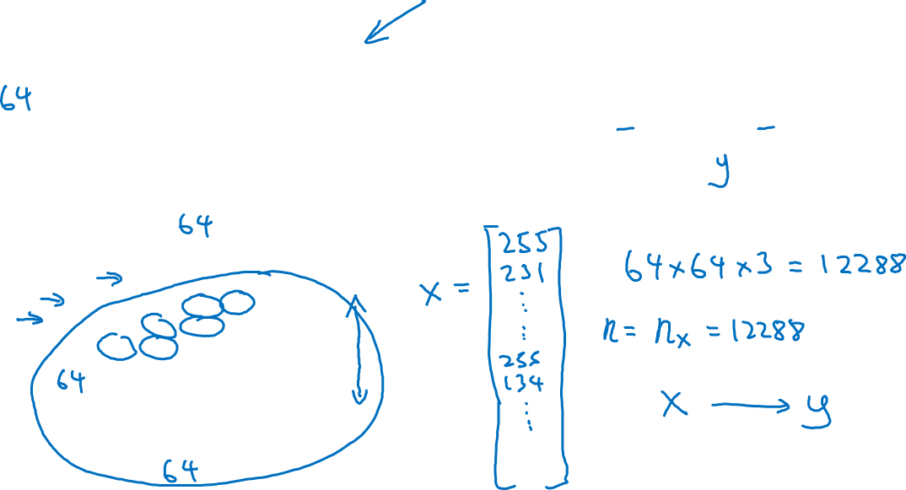
Binary Classification
1 (cat) vs 0 (non cat)
Blue
Green
Red

Slide 3
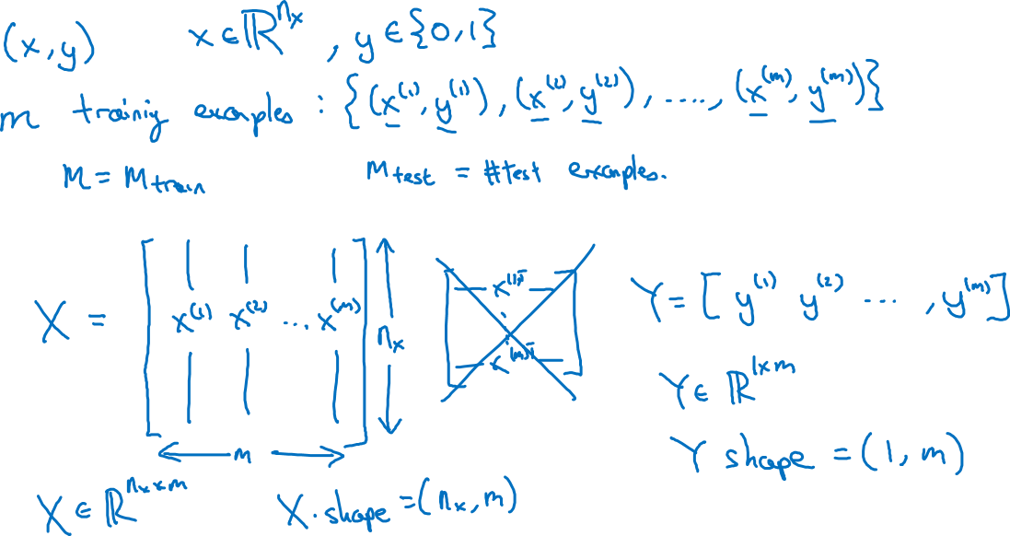
Notation

